Slide 1
CS4104 Applied Machine Learning
Instructor: Dr. Kashif Zafar
March 26, 2025
Correlation
Lecture No. 13a

Slide 2
Covariance
Covariance measures the direction of the relationship between two variables.
A positive covariance means that both variables tend to be high or low at the same time.
A negative covariance means that when one variable is high, the other tends to be low

Slide 3
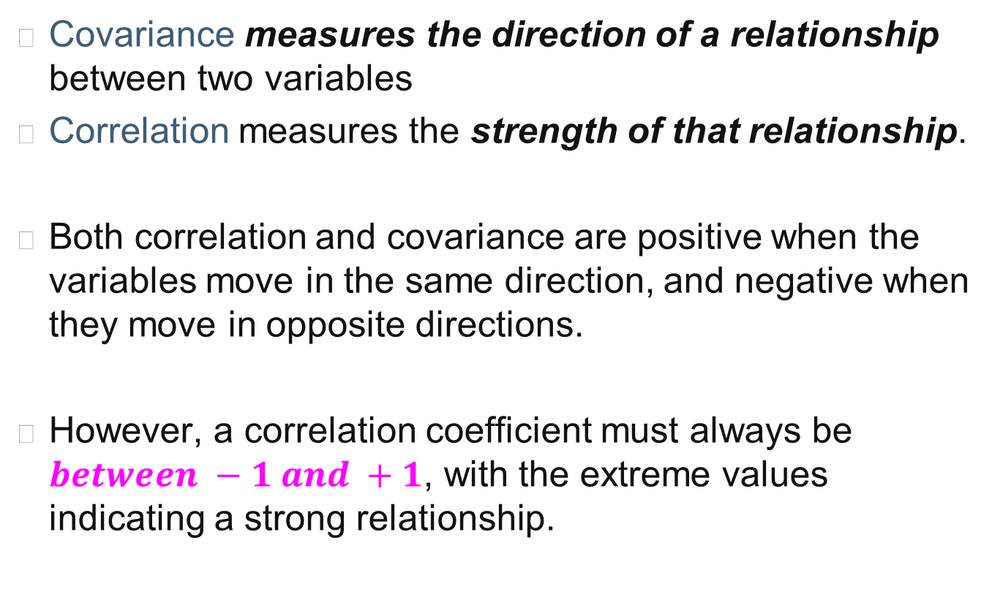
Covariance vs Correlation Coefficient
Covariance measures the direction of a relationship between two variables
Correlation measures the strength of that relationship.
Both correlation and covariance are positive when the variables move in the same direction, and negative when they move in opposite directions.
However, a correlation coefficient must always be $between −1 and +1$, with the extreme values indicating a strong relationship.

Slide 4
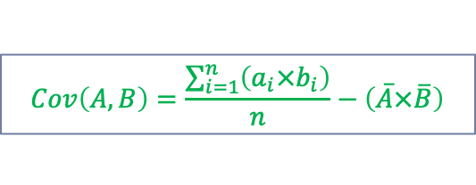
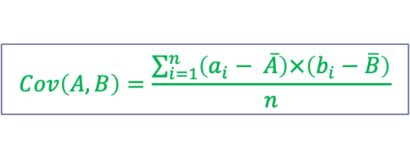
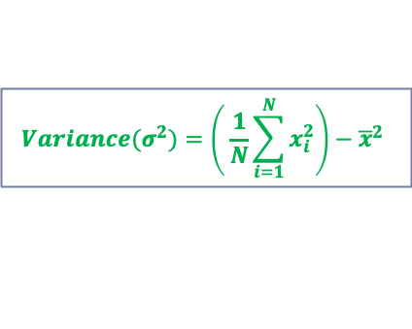
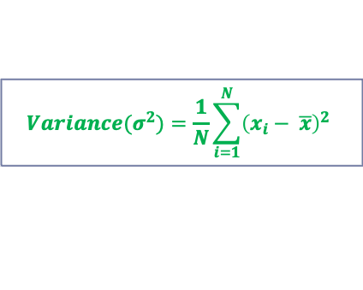
Computing Covariance
Recall from Lecture 4:
$$Cov\left(A,B\right)=\frac{\sum_{i=1}^{n}{\left(a_{i}− \overline{A}\right)×\left(b_{i}−\overline{B}\right)}}{n}$$
$${Variance(σ}^{2})=\frac{1}{N}\sum_{i=1}^{N}{{\left(x_{i}− \overline{x}\right)}^{2}}$$
Average of variable A
Average of variable B
$${Variance(σ}^{2})=\left( \frac{1}{N}\sum_{i=1}^{N}{x_{i}^{2}}\right)−{\overline{x}}^{2}$$
$$Cov\left(A,B\right)=\frac{\sum_{i=1}^{n}{\left(a_{i}×b_{i}\right)}}{n}−\left(\overline{A}×\overline{B}\right)$$
Note: Variance is special case of covariance where two attributes are identical (covariance with itself)

Slide 5
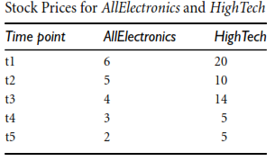



Computing Covariance
$$Cov\left(A,B\right)=\frac{\sum_{i=1}^{n}{\left(a_{i}×b_{i}\right)}}{n}−\left(\overline{A}×\overline{B}\right)$$
$$\overline{A} \left(AllElectronics\right)=\frac{6+5+4+3+2}{5}=\frac{20}{5}=4$$
$$\overline{B}\left(HighTech\right)=\frac{20+10+14+5+5}{5}=\frac{54}{5}=10.80$$
$$Cov\left(AllElectronics, HighTech\right)=\frac{6×20+5×10+4×14+3×5+2×5}{5}−4×10.80$$
$$Cov\left(AllElectronics, HighTech\right)=50.2−43.2$$
$$Cov\left(AllElectronics, HighTech\right)=7$$
What if the data is nominal?
Notes:
The index of qualitative variation (IQV) is a measure of variability for nominal variables such as race and ethnicity. The index can vary from 0.00 to 1.00. When all the cases in the distribution are in one category, there is no variation (or diversity) and the IQV is 0.00. In contrast, when the cases in the distribution are distributed evenly across the categories, there is maximum variation (or diversity) and the IQV is 1.00.
Index of qualitative variation (IQV) A measure of variability for nominal variables. It is based on the ratio of the total number of differences in the distribution to the maximum number of possible differences within the same distribution.

Slide 6
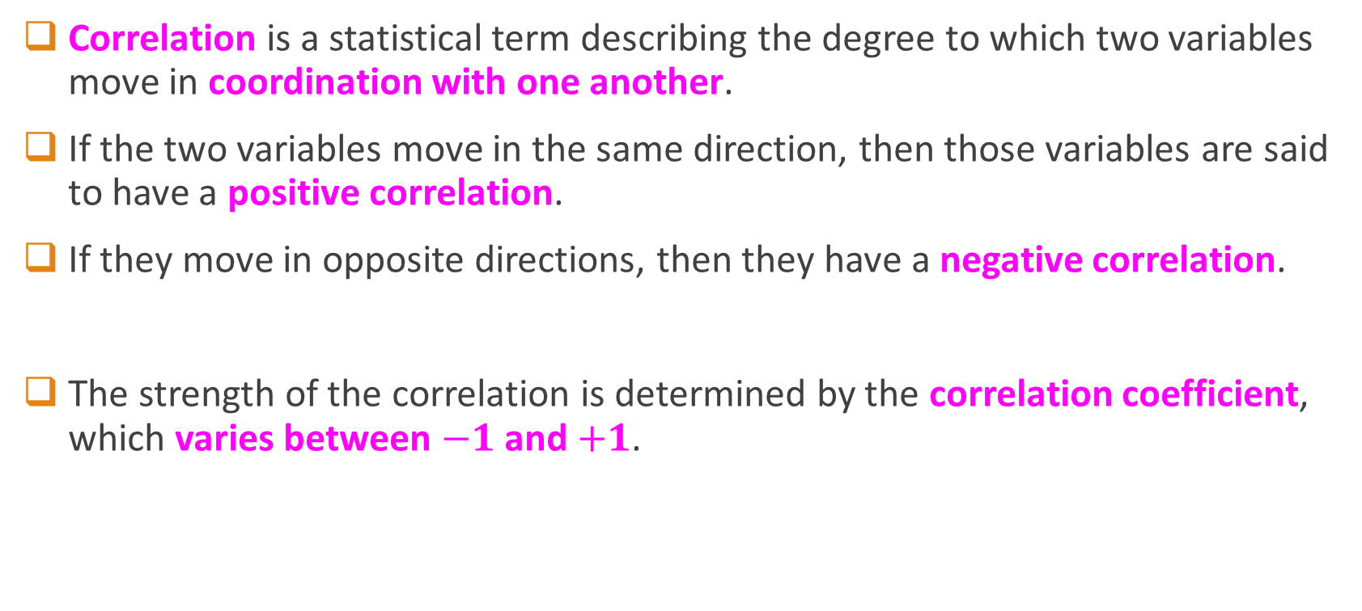
Correlation
Correlation is a statistical term describing the degree to which two variables move in coordination with one another.
If the two variables move in the same direction, then those variables are said to have a positive correlation.
If they move in opposite directions, then they have a negative correlation.
The strength of the correlation is determined by the correlation coefficient, which varies between $−1$ and $+1$.
What if correlation is 0?

Slide 7
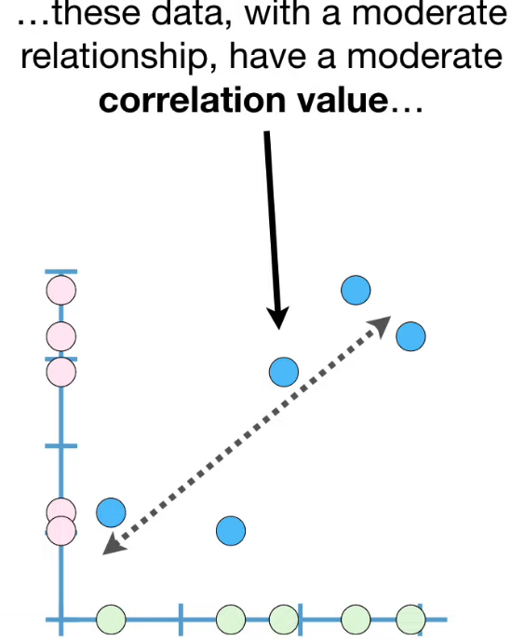
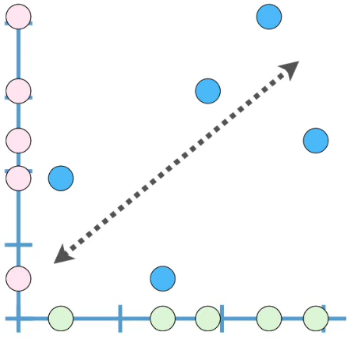
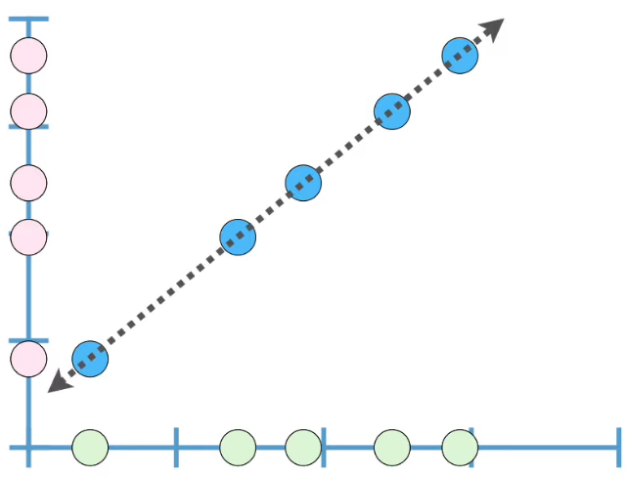
Correlation Between Two Variables
Correlation is 1 if a straight line with positive slope can be drawn from the center of all data points
Weak relationship have small correlation value…
Strong relationship have large correlation value…

Slide 8
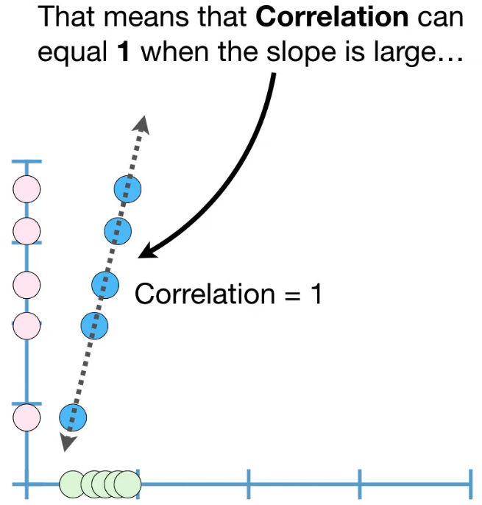
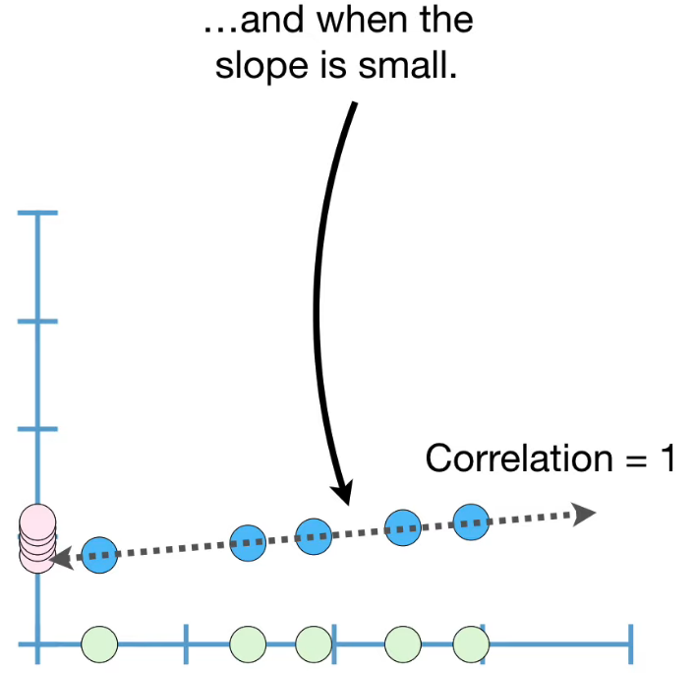
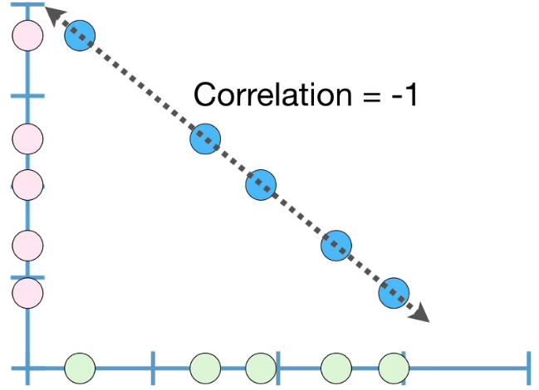
Correlation Between Two Variables

Slide 9
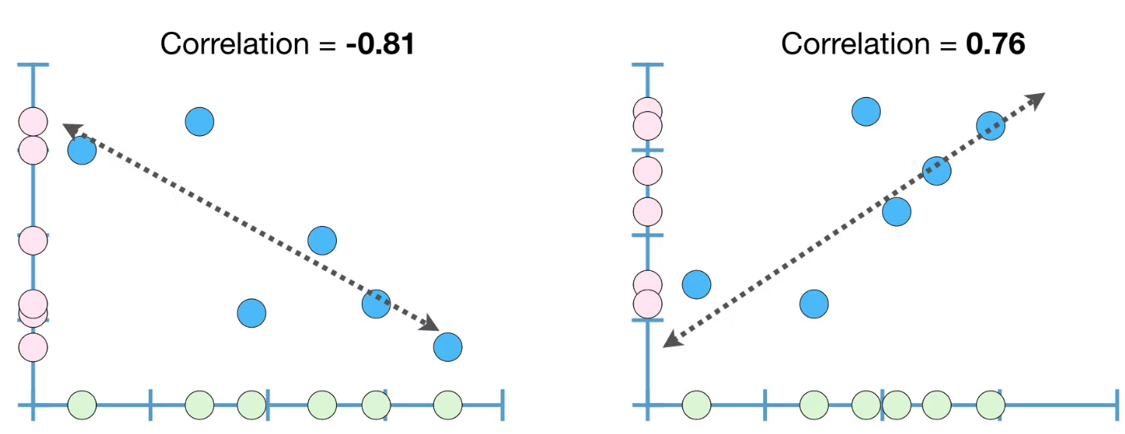
Correlation Between Two Variables

Slide 10
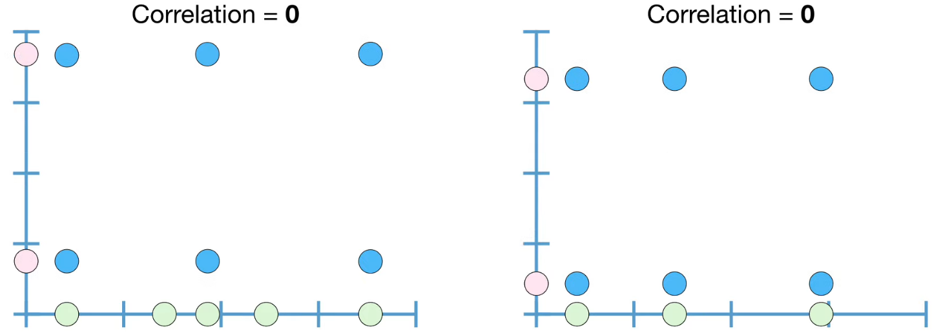
Correlation Between Two Variables
But … How to Compute Correlation?

Slide 11
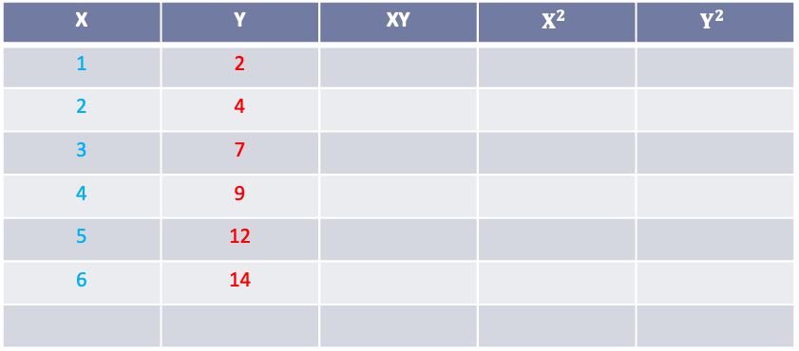
Computing Correlation
X | Y
1 | 2
2 | 4
3 | 7
4 | 9
5 | 12
6 | 14
X | Y | XY | $$X^{2}$$ | $$Y^{2}$$
1 | 2
2 | 4
3 | 7
4 | 9
5 | 12
6 | 14

Slide 12
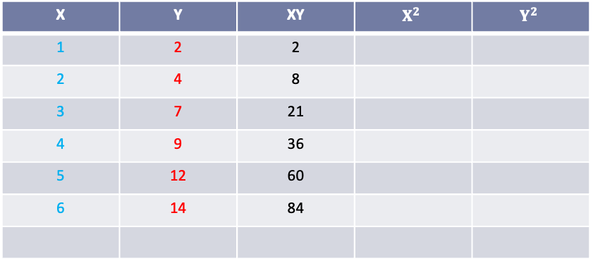
Computing Correlation
X | Y
1 | 2
2 | 4
3 | 7
4 | 9
5 | 12
6 | 14
X | Y | XY | $$X^{2}$$ | $$Y^{2}$$
1 | 2 | 2
2 | 4 | 8
3 | 7 | 21
4 | 9 | 36
5 | 12 | 60
6 | 14 | 84

Slide 13
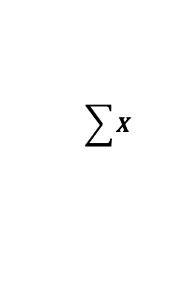
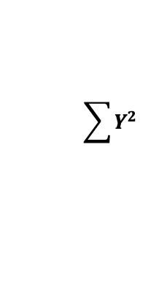
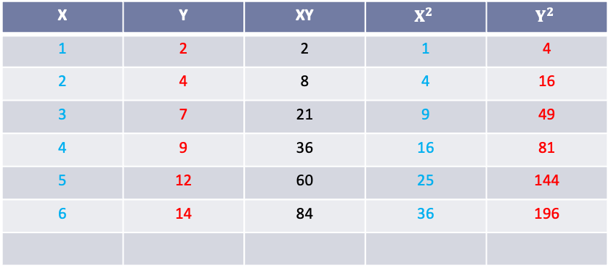
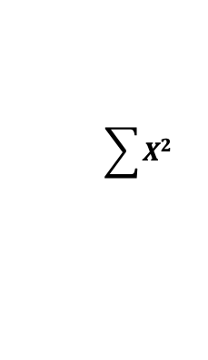
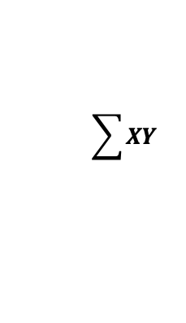
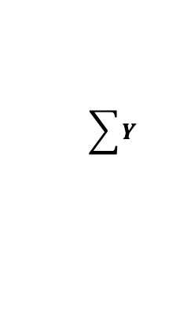
Computing Correlation
X | Y
1 | 2
2 | 4
3 | 7
4 | 9
5 | 12
6 | 14
X | Y | XY | $$X^{2}$$ | $$Y^{2}$$
1 | 2 | 2 | 1 | 4
2 | 4 | 8 | 4 | 16
3 | 7 | 21 | 9 | 49
4 | 9 | 36 | 16 | 81
5 | 12 | 60 | 25 | 144
6 | 14 | 84 | 36 | 196
21
48
211
91
490
$$\sum{X}$$
$$\sum{Y}$$
$$\sum{XY}$$
$$\sum{X^{2}}$$
$$\sum{Y^{2}}$$

Slide 14
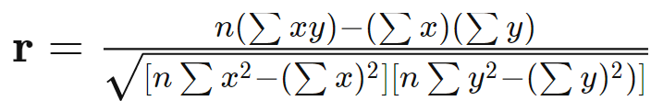
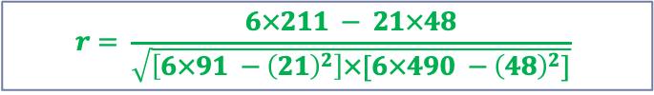
Computing Correlation
X | Y
1 | 2
2 | 4
3 | 7
4 | 9
5 | 12
6 | 14
$$r= \frac{6×211 − 21×48}{\sqrt{\left[6×91 −{\left(21\right)}^{2}\right]×[6×490 −{\left(48\right)}^{2}]}}$$
$$r= \frac{1266−1008}{\sqrt{\left[546−441\right]×[2940 −2304]}}=\frac{258}{\sqrt{105×636 }}=\frac{258}{\sqrt{66780}}=0.998$$
21
48
211
91
490
This is “Pearson’s Correlation Coefficient”
$$\sum{X}$$
$$\sum{Y}$$
$$\sum{XY}$$
$$\sum{X^{2}}$$
$$\sum{Y^{2}}$$
More Details: https://www.investopedia.com/ask/answers/032515/what-does-it-mean-if-correlation-coefficient-positive-negative-or-zero.asp

Slide 15
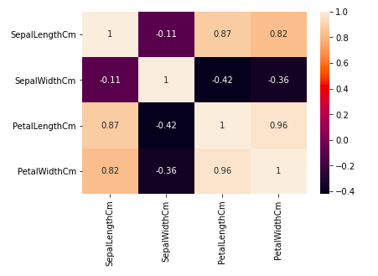
Correlation of Multiple Variables
IRIS Dataset: Again…
Heatmap

Slide 16
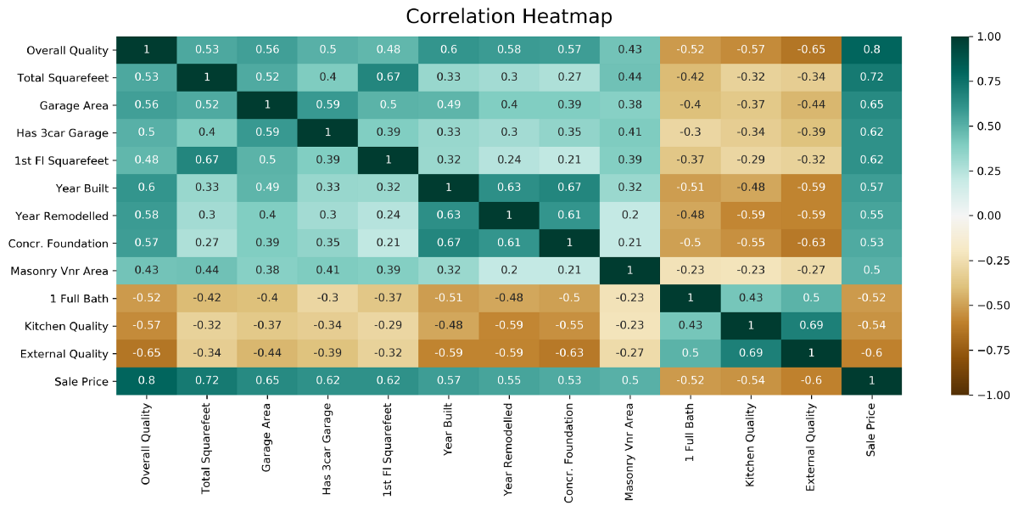
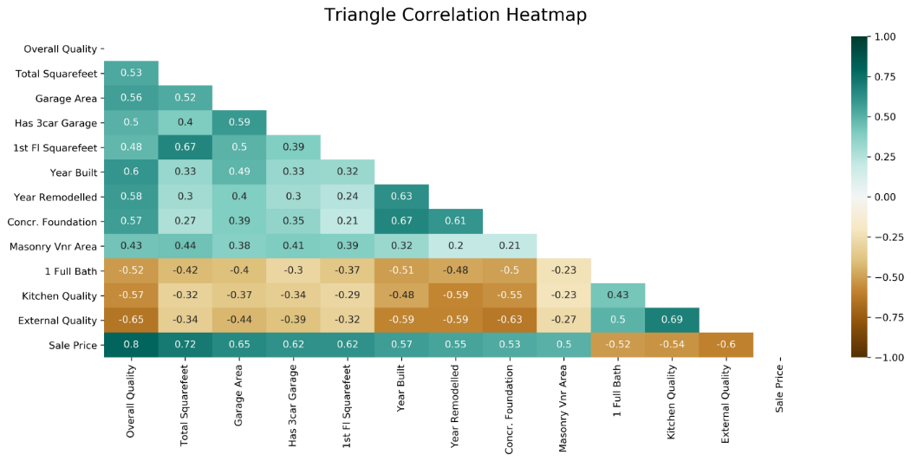
Correlation Heatmaps: Complex Examples
We can also create heatmaps for Similarity and Dissimilarity (Distance) between two objects/records…
But … What is similarity and dissimilarity between two objects and how to measure it?

Slide 17
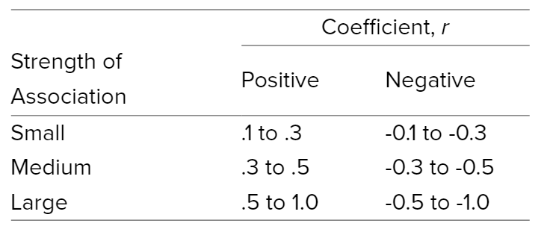
Correlation Interpretation
More Details: https://statistics.laerd.com/statistical-guides/pearson-correlation-coefficient-statistical-guide.php

Slide 18
Correlation does NOT imply causality…
if A and B are correlated, this does not necessarily imply that A causes B or that B causes A.
For example, in analyzing a demographic database, we may ﬁnd that attributes representing the number of hospitals and the number of car thefts in a region are correlated.
This does not mean that one causes the other.
Both are actually causally linked to a third attribute, namely, population.

Slide 19
What Correlation Tells Us?
Some attributes are redundant
Redundancy here means that an attribute (such as annual_revenue) may be redundant if it can be “derived” from other attribute or set of attributes.
Inconsistencies in attribute (or dimension) naming can also cause redundancies in the resulting dataset.
Some redundancies can be detected by correlation analysis.

Slide 20
Covariance vs Correlation
Covariance : Direction (any value)
Correlation: Direction and Strength (-1 to +1)

Slide 21
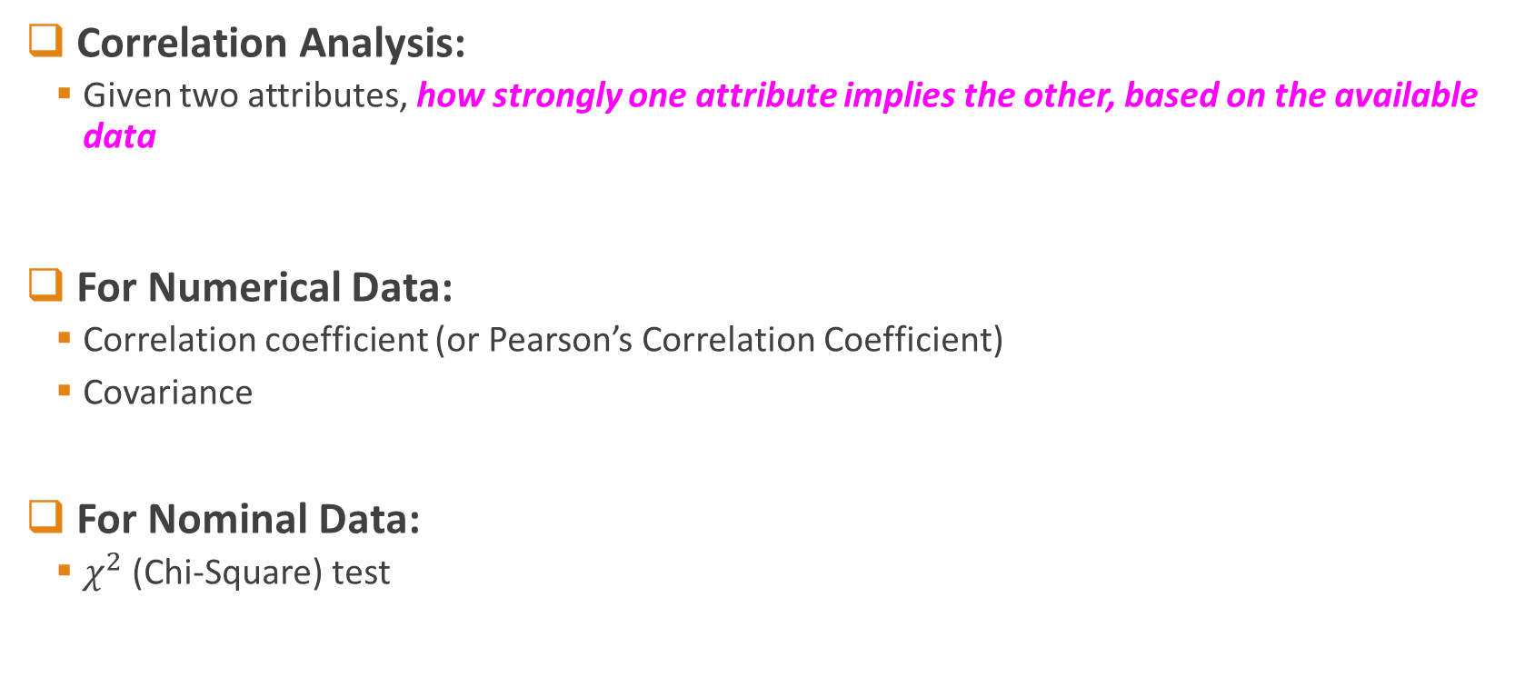
Correlation Analysis
Correlation Analysis:
Given two attributes, how strongly one attribute implies the other, based on the available data
For Numerical Data:
Correlation coefficient (or Pearson’s Correlation Coefficient)
Covariance
For Nominal Data:
$χ^{2}$ (Chi-Square) test

Slide 22
Reading
Chap 2 nd 3 (Han and Kamber)

Slide 23
Activity
Calculate Correlation between these two variables X, Y
X | Y
2 | 10
4 | 9
6 | 8
8 | 7
10 | 6

Slide 24
Activity
Calculate Covariance of the following two variables X, Y
X | Y
2.1 | 8
2.5 | 10
3.6 | 12
4 | 14

